Slide 1

CERTIFICATE III IN AUTOMOTIVE REPAIR & MAINTENANCE
SUBJECT:VEHICLE MAINTENACE AND REPAIR
By Ibrahim siraj
Maldives polytechnic

Slide 2
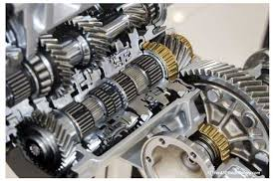
VEHICLE MAINTENACE AND REPAIR
Chapter 14 Service Final Drive Assembly Components
Introduction
A car's final drive assembly is the last set of gears in the drivetrain that reduces engine speed (RPM) and increases torque before sending power to the wheels. It is located either in the transmission/transaxle (for front-wheel drive) or in the rear axle (for rear-wheel drive). This assembly also contains the differential, which allows the two drive wheels to rotate at different speeds when turning
By Ibrahim siraj
Maldives polytechnic

Slide 3
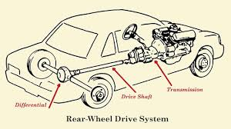
VEHICLE MAINTENACE AND REPAIR
Chapter 14 Service Final Drive Assembly Components
Drive Components
the system of components that transfers power from the engine to the wheels,
four main types being front-wheel drive (FWD), rear-wheel drive (RWD), all-wheel drive (AWD), and four-wheel drive (4WD).
Key parts of the drivetrain include the transmission, which adjusts gear ratios, and the driveshaft or half-shafts, which transmit power to the differential, which then directs it to the drive wheels.
By Ibrahim siraj
Maldives polytechnic

Slide 4
VEHICLE MAINTENACE AND REPAIR
Chapter 14 Service Final Drive Assembly Components
The drivetrain Components
Transmission: Adjusts engine speed and torque to control vehicle speed and power output, including reverse functionality.
Driveshaft: A rotating shaft that transfers torque from the transmission to the differential(s) (present in RWD, AWD, 4WD).
Differential: A set of gears that allows the wheels on the same axle to rotate at different speeds, which is essential for turning corners smoothly.
Axles/Half-shafts: Connect the differential to the drive wheels, transmitting the final power.
Transfer Case: An extra component found in 4WD and some AWD systems that splits power between the front and rear axles and often provides low-range gearing for off-road use
By Ibrahim siraj
Maldives polytechnic

Slide 5
VEHICLE MAINTENACE AND REPAIR
Chapter 14 Service Final Drive Assembly Components
Transmission: Adjusts engine speed and torque to control vehicle speed and power output, including reverse functionality.
Vary torque and speed: Lower gears provide more torque (pulling power) to get the car moving from a standstill or climb hills, while higher gears allow for greater speed at lower engine revolutions per minute (RPM) for better fuel efficiency.
Enable reversing: The transmission includes a reverse gear, allowing the vehicle to move backward
Allow the vehicle to stop without stalling the engine by temporarily disconnecting the engine from the drive wheels (via a clutch or torque converter).
By Ibrahim siraj
Maldives polytechnic

Slide 6
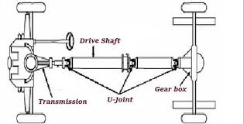
VEHICLE MAINTENACE AND REPAIR
Chapter 14 Service Final Drive Assembly Components
The drivetrain Components
Driveshaft: A rotating shaft that transfers torque from the transmission to the differential(s) (present in RWD, AWD, 4WD).
A drive shaft, also called a propeller shaft or prop shaft, is a crucial component of a vehicle's drivetrain that transmits torque (rotational power) from the transmission to the wheels, enabling the vehicle to move
By Ibrahim siraj
Maldives polytechnic

Slide 7
VEHICLE MAINTENACE AND REPAIR
Chapter 14 Service Final Drive Assembly Components
The drivetrain Components
Driveshaft: A rotating shaft that transfers torque from the transmission to the differential(s) (present in RWD, AWD, 4WD).
Components
Shaft: A long, tubular component, typically made of steel or aluminum, designed to withstand high torque and vibration.
Universal Joints (U-joints) or Constant Velocity (CV) Joints: Flexible couplings that allow the drive shaft components to rotate at different angles relative to each other, which is essential for the wheels to move up and down with the suspension and for steering.
Slip Yoke: A sliding mechanism that accommodates changes in the drive shaft's length as the suspension moves up and down.
Flange Yoke: Connects the drive shaft to the transmission and differential with bolts to ensure a secure connection.
Center Bearing: A support bearing used in longer, two-piece drive shafts to reduce vibration and provide stability.
Drive Shaft Boot: A protective rubber or flexible cover that protects the CV or U-joints from dirt and water while keeping the lubricating grease from leaking out.
By Ibrahim siraj
Maldives polytechnic

Slide 8
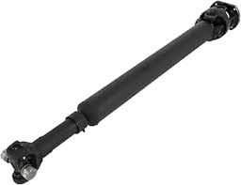
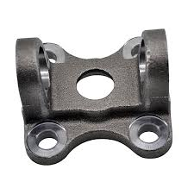
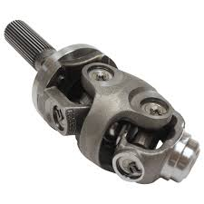
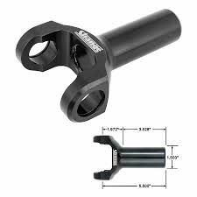
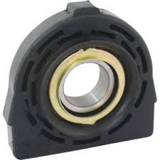
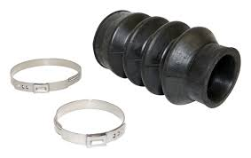
VEHICLE MAINTENACE AND REPAIR
Chapter 14 Service Final Drive Assembly Components
The drivetrain Components
Driveshaft: A rotating shaft that transfers torque from the transmission to the differential(s) (present in RWD, AWD, 4WD).
Components
Shaft: Universal Joints (U-joints) or Constant Velocity (CV) Joints
Slip Yoke: Flange Yoke: Center Bearing:
Drive Shaft Boot:
By Ibrahim siraj
Maldives polytechnic

Slide 9
VEHICLE MAINTENACE AND REPAIR
Chapter 14 Service Final Drive Assembly Components
The drivetrain Components
Differential: A set of gears that allows the wheels on the same axle to rotate at different speeds, which is essential for turning corners smoothly.
Purpose: To transmit engine power to the wheels and accommodate the difference in wheel speeds during turns
Location: The differential is typically part of the axle assembly. In front-wheel drive cars, it's often combined with the transmission in a unit called a transaxle; in rear-wheel drive cars, it's located between the rear wheels
Types: Common types include open, limited-slip, locking, and torque-vectoring differentials, each offering different performance characteristics, especially in low-traction conditions or high-performance applications
By Ibrahim siraj
Maldives polytechnic

Slide 10
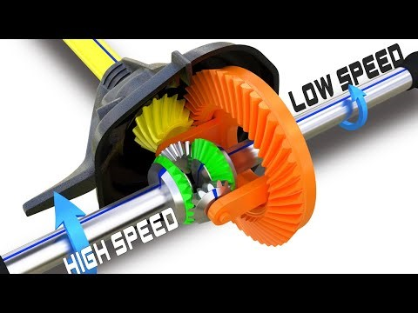
VEHICLE MAINTENACE AND REPAIR
Chapter 14 Service Final Drive Assembly Components
The drivetrain Components
Differential: A set of gears that allows the wheels on the same axle to rotate at different speeds, which is essential for turning corners smoothly.
By Ibrahim siraj
Maldives polytechnic

Slide 11
VEHICLE MAINTENACE AND REPAIR
Chapter 14 Service Final Drive Assembly Components
The drivetrain Components
Axles/Half-shafts: Connect the differential to the drive wheels, transmitting the final power.
Axle: An axle is a central shaft for a rotating wheel or gear. Its primary function is to support the weight of the vehicle and its cargo.
Axles can be dead (non-driven) or live (driven by the engine).
In modern passenger cars, the term "axle" often refers to the entire assembly, including the housing, shafts, and differential.
Half-shaft: A half-shaft is a specific type of axle shaft that extends from the differential (or transaxle) to an individual wheel.
They are called "half" shafts because there are two of them, one for each wheel, making up the full drive axle assembly.
These components are primarily responsible for transmitting the rotational force (torque) from the differential to the wheels, allowing them to spin.
By Ibrahim siraj
Maldives polytechnic

Slide 12
VEHICLE MAINTENACE AND REPAIR
Chapter 14 Service Final Drive Assembly Components
The drivetrain Components
Axles/Half-shafts: Connect the differential to the drive wheels, transmitting the final power.
Key Differences and Functions.
The main distinction lies in their primary function and the stresses they endure:
Weight Bearing: The general axle assembly (housing) supports the vehicle's weight, while the axle shafts themselves are primarily designed to withstand the torsional stress of power transmission.
Power Transmission: Half-shafts are designed to transmit torque, allowing the wheels to move the car.
Flexibility: In modern independent suspension systems (common in front-wheel-drive cars), half-shafts use constant velocity (CV) joints at both ends. These joints allow the shaft to flex and change angle as the wheels turn and the suspension moves up and down, ensuring smooth and consistent power delivery without binding
By Ibrahim siraj
Maldives polytechnic

Slide 13
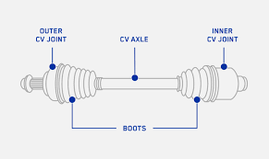
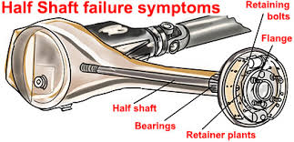
VEHICLE MAINTENACE AND REPAIR
Chapter 14 Service Final Drive Assembly Components
The drivetrain Components
Axles/Half-shafts: Connect the differential to the drive wheels, transmitting the final power.
It gets its name because a single half shaft only performs half of the work required for the axle
By Ibrahim siraj
Maldives polytechnic

Slide 14
VEHICLE MAINTENACE AND REPAIR
Chapter 14 Service Final Drive Assembly Components
Rear-Wheel Drive (RWD) is a drivetrain layout where engine power is delivered only to the rear wheels of the vehicle. In most RWD cars, the engine is located in the front, and a driveshaft runs the length of the vehicle to power the rear axle.
Weight Distribution: RWD systems typically have a more balanced weight distribution between the front and rear axles compared to FWD systems. This balance contributes to better handling and stability, especially during acceleration and aggressive cornering.
Performance & Handling: Because the front wheels are responsible only for steering, and the rear wheels are responsible for power delivery, RWD vehicles often offer a purer, more engaging driving experience favored by performance enthusiasts. This setup allows for better acceleration as weight shifts to the rear wheels, increasing traction on launch
Towing & Heavy Loads: The robust rear differential setup makes RWD an efficient choice for trucks and SUVs designed to carry heavy loads or tow trailers
By Ibrahim siraj
Maldives polytechnic

Slide 15
VEHICLE MAINTENACE AND REPAIR
Chapter 14 Service Final Drive Assembly Components
Traction in Slippery Conditions: RWD vehicles can struggle in snow, ice, and heavy rain because the majority of the vehicle's weight (the engine) is not positioned directly over the drive wheels, making them more prone to "oversteer" (fishtailing or losing rear-end traction). Modern traction control and stability control systems mitigate this risk significantly.
Interior Space: The driveshaft tunnel required to run power to the back axle can slightly reduce rear passenger legroom and interior cabin space compared to FWD layouts.
Common Applications
RWD is a popular choice for:
Sports cars and Performance Sedans: Vehicles like the BMW 3 Series, Lexus IS, and Ford Mustang use RWD because of its superior handling characteristics.
Trucks and Large SUVs: The power delivery and weight handling capabilities make RWD a staple for pickup trucks (like the Ford F-150 or Chevrolet Silverado) and many full-size SUVs (like the Chevrolet Tahoe).
Luxury Vehicles: Many high-end luxury brands favor RWD for its smooth performance and balanced ride quality.
By Ibrahim siraj
Maldives polytechnic

Slide 16
VEHICLE MAINTENACE AND REPAIR
Chapter 14 Service Final Drive Assembly Components
Rear-Wheel Drive (RWD)
A rear-wheel drive (RWD) system delivers engine power exclusively to the rear wheels, propelling the vehicle forward.
This is often found in performance and luxury cars, as it can lead to better handling, acceleration, and weight balance because the front wheels are only responsible for steering.
However, RWD can struggle with traction in slippery conditions like rain or snow, though modern stability and traction control systems help mitigate this issue
By Ibrahim siraj
Maldives polytechnic

Slide 17
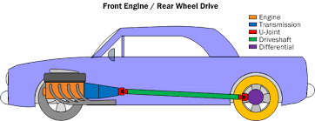
VEHICLE MAINTENACE AND REPAIR
Chapter 14 Service Final Drive Assembly Components
By Ibrahim siraj
Maldives polytechnic

Slide 18
VEHICLE MAINTENACE AND REPAIR
Chapter 14 Service Final Drive Assembly Components
Rear-Wheel Drive (RWD)
Advantages of Rear-Wheel Drive
Superior Handling and Balance RWD vehicles generally have a more balanced weight distribution (often close to 50:50 between front and rear), which improves stability and cornering.
Enhanced Steering Feel The front wheels are responsible solely for steering, not power delivery, leading to more responsive, communicative, and precise steering.
Better Acceleration (in dry conditions) During acceleration, the vehicle's weight shifts to the rear, increasing the grip on the rear drive wheels and allowing for more efficient power delivery and faster launches from a stop.
No Torque Steer RWD cars are free from "torque steer", a phenomenon in high-powered front-wheel drive cars where the steering pulls to one side under heavy acceleration.
Ideal for High Horsepower and Towing The system is generally more robust and better able to handle high power outputs and heavy loads, making it suitable for sports cars, trucks, and performance vehicles.
Simpler Front Suspension The front suspension design is simpler when it only handles steering and braking, which can lead to less complex maintenance on those components.
By Ibrahim siraj
Maldives polytechnic

Slide 19
VEHICLE MAINTENACE AND REPAIR
Chapter 14 Service Final Drive Assembly Components
FWD Front wheel drive
Front-Wheel Drive (FWD) is a drivetrain configuration where power is delivered exclusively to the front wheels, which are responsible for both steering and propelling the vehicle. It is the most common layout in modern cars, particularly in compact and mid-size sedans and SUVs
Advantages of FWD
Better Traction in Poor Weather: Because the engine's weight sits directly over the drive wheels, FWD vehicles have superior traction on wet, snowy, or icy roads compared to RWD cars.
Fuel Efficiency: The system is more compact and lighter because it eliminates the need for a long driveshaft running to the back of the car. Fewer moving parts mean less energy loss, leading to better fuel economy.
More Interior Space: The compact, all-in-one powertrain design frees up cabin space by eliminating the large transmission tunnel typically found in RWD and AWD vehicles, providing a flatter floor and more legroom for passengers.
Lower Cost: FWD systems are generally simpler to manufacture and maintain, which often translates to a lower purchase price and reduced maintenance costs for the owner.
By Ibrahim siraj
Maldives polytechnic

Slide 20
VEHICLE MAINTENACE AND REPAIR
Chapter 14 Service Final Drive Assembly Components
Four-wheel drive (4WD or 4x4)
Four-wheel drive (4WD or 4x4) is a vehicle drivetrain system designed primarily for off-road use that delivers power to all four wheels simultaneously for maximum traction
It typically requires manual engagement by the driver and uses a transfer case to split power between the front and rear axles.
How Four-Wheel Drive Works
In a 4WD system, engine power is sent through the transmission to a transfer case, which then distributes that power to both the front and rear axles. A key feature of traditional 4WD systems is that when engaged, the front and rear axles are rigidly coupled and turn at the same speed (unless an inter-axle differential is used in a "full-time" system). This ensures maximum torque and traction in slippery or rugged conditions. The system usually offers different modes, such as
By Ibrahim siraj
Maldives polytechnic

Slide 21
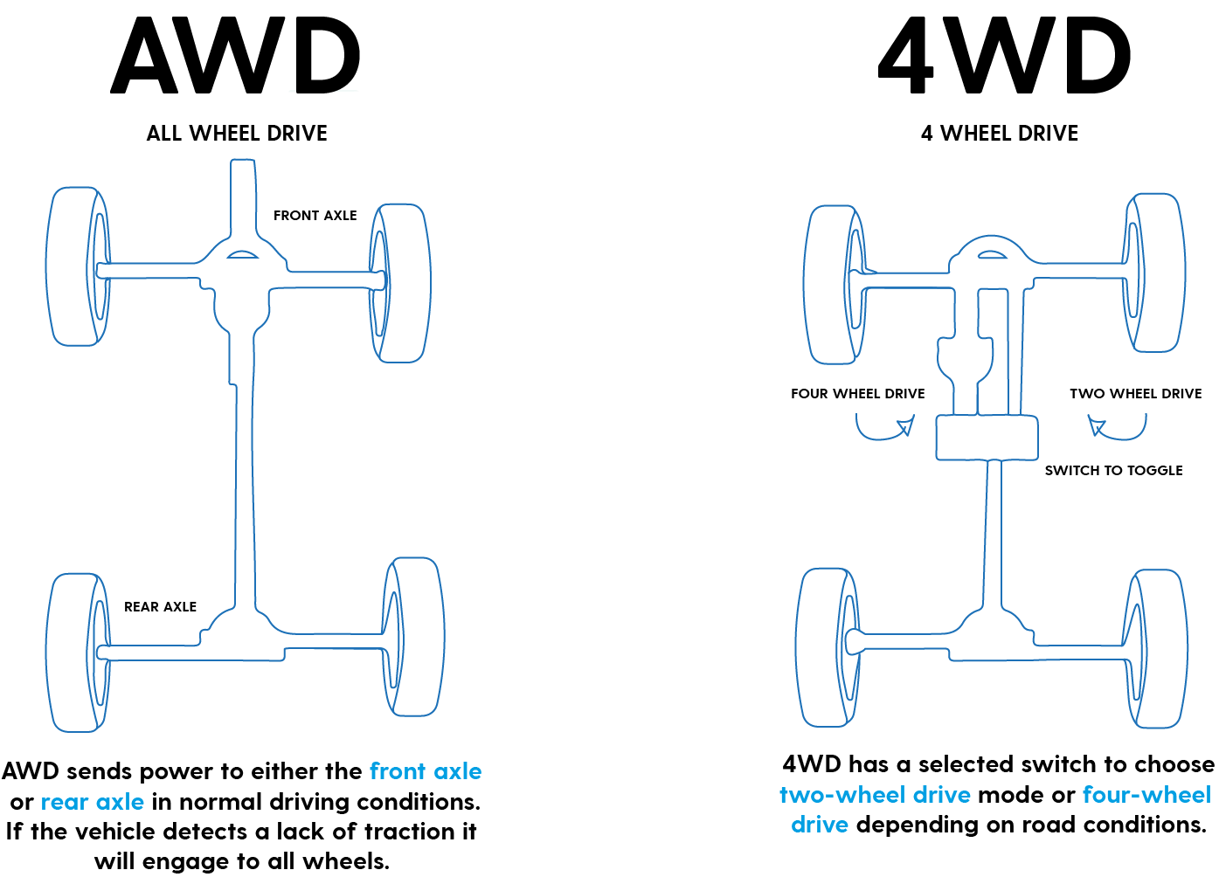
VEHICLE MAINTENACE AND REPAIR
Chapter 14 Service Final Drive Assembly Components
Four-wheel drive (4WD or 4x4)
By Ibrahim siraj
Maldives polytechnic

Slide 22
VEHICLE MAINTENACE AND REPAIR
Chapter 14 Service Final Drive Assembly Components
Four-wheel drive (4WD or 4x4)
2WD Mode: The default for normal, dry pavement driving, where only one axle (usually the rear) receives power, improving fuel efficiency.
4WD High (4H): Used for slippery surfaces like snowy or icy paved roads, dirt roads, and gravel, where a reasonable speed can be maintained.
4WD Low (4L): Used for extreme off-road conditions such as deep mud, sand, rock crawling, or steep inclines/declines, where maximum torque at low speeds is needed.
By Ibrahim siraj
Maldives polytechnic

Slide 23
VEHICLE MAINTENACE AND REPAIR
Chapter 14 Service Final Drive Assembly Components
All Wheel Drive (AWD)
All-wheel drive (AWD) is a vehicle drivetrain system that automatically sends power to all four wheels as needed for enhanced on-road traction and stability in various conditions like rain, snow, or ice.
It generally operates without driver intervention and is engineered primarily for safety and performance on paved or lightly unpaved surfaces, rather than severe off-roading.
How All-Wheel Drive Works
AWD systems are "always on" (full-time) or automatically engage (part-time or on-demand) when sensors detect wheel slippage. The system uses a center differential or a viscous coupling (instead of a rugged transfer case with low-range gearing found in most 4WD systems) to manage torque distribution to the wheels that have the most grip. This allows all four wheels to rotate at different speeds when cornering on dry pavement, which is essential for safe handling and preventing damage to the drivetrain (known as "wind-up")
By Ibrahim siraj
Maldives polytechnic

Slide 24
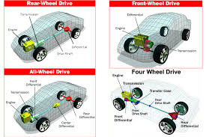
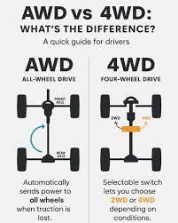
VEHICLE MAINTENACE AND REPAIR
Chapter 14 Service Final Drive Assembly Components
All Wheel Drive (AWD)
By Ibrahim siraj
Maldives polytechnic

Slide 25
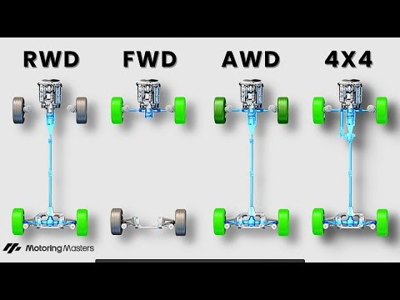
VEHICLE MAINTENACE AND REPAIR
Chapter 14 Service Final Drive Assembly Components
All Wheel Drive (AWD)
By Ibrahim siraj
Maldives polytechnic

Slide 26
THANK YOU

